Slide 1
SkyAid Sync up with JP team
Zuqi Xia
CDC Consumer Service Team

Slide 2

techie terms in the past months…

Slide 3
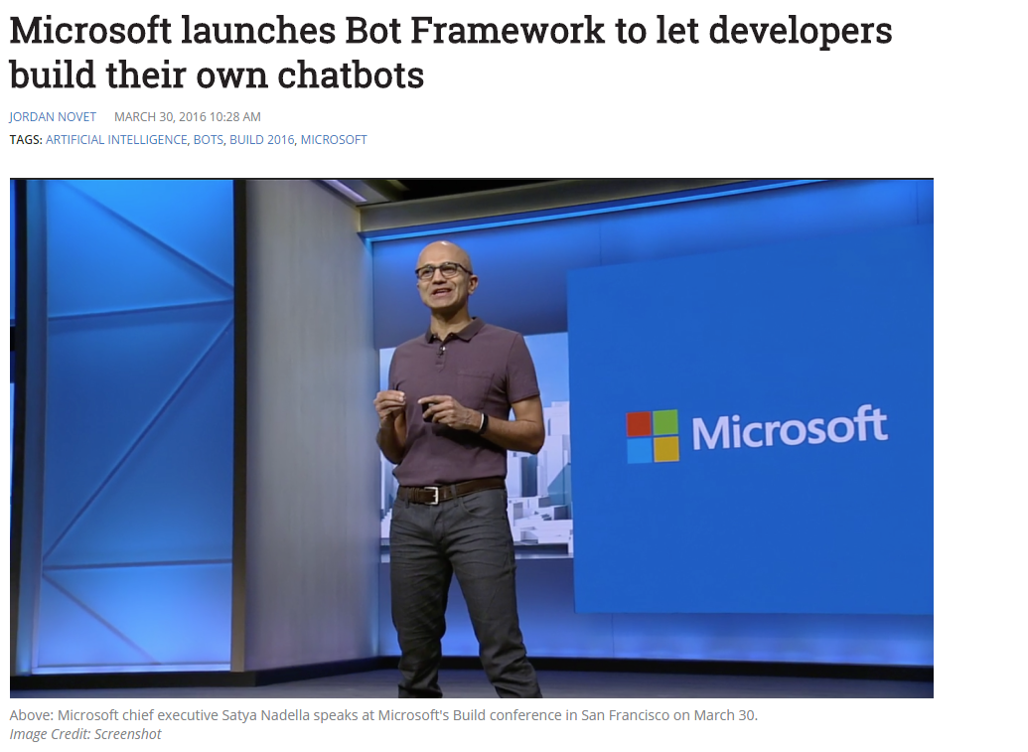
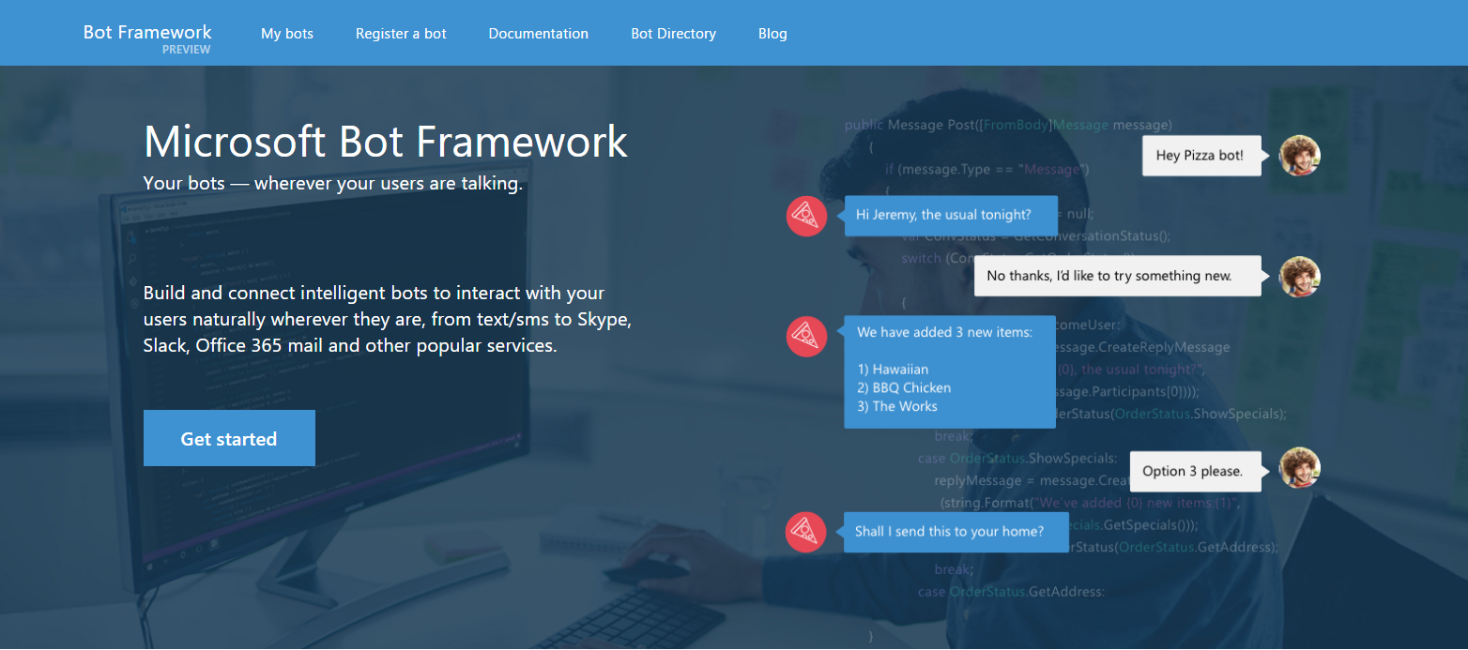

Slide 4
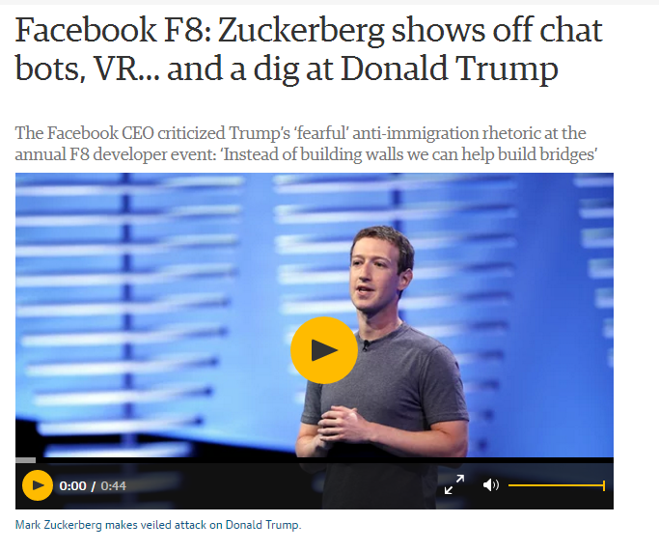
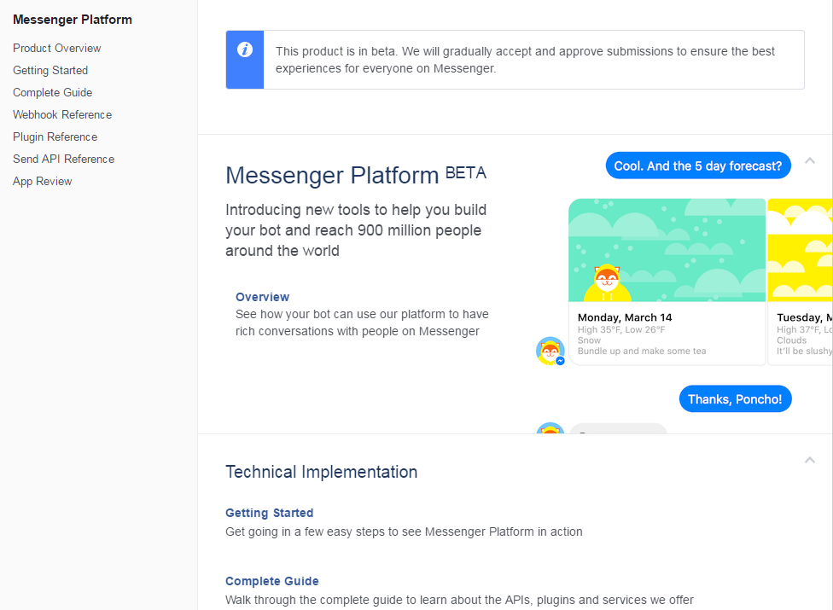

Slide 5
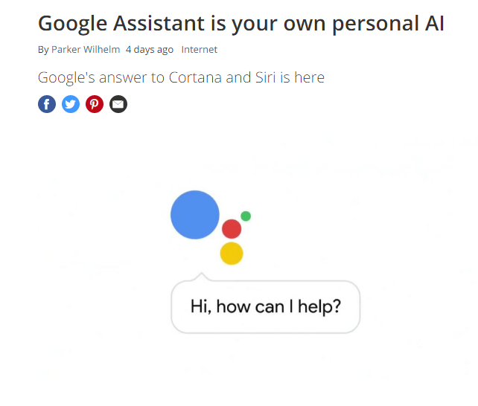

Slide 6




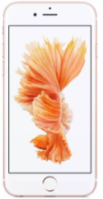
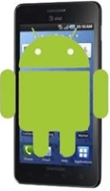



Our Vision
Assist Anytime from Any device for Any issue
Entry to Support
Brain for Support
TM Product Intelligence
Platform General Intelligence
……

Slide 7
SkyAid in Y2016
Intelligence for Windows
Bot framework

Slide 8
Intelligence for Windows
SEM Automation
GCC Intelligence
App Ontology
Case Handling Process automation & standardization
Best Practice Tuning
Case Auto Categorization
Validated with L1 & Social Support team
PUA Detection
App Vulnerability Scan
Risk Estimation Service
Self Service for End Users

Slide 9

Bot framework Research
Make Bot Service more human-like

Slide 10
Challenge for Bot Service
Language Issue
Data source/clean issue
Solution Validation Issue

Slide 11
Help needed for Support
how to have more close collaboration to:
Get useful data source
Validate the solution
Ask help for any issue

Slide 12


